Slide 1
Lecture 12 – Review for Midterm 1
2018.02.05
On mobile, what are the core apps?It's basically messaging, mapping and review data.
– Jeremy Stoppelman
Yelp CEO and co-founder

Slide 2
Week 04 assignments
Re-read chapter 3
HW 03 due Thursday, Feb 01
Lab 04 starts Jan. 30, due following week
Notes:
15 clickers recorded, but without associated student name

Slide 3
Midterm 1 information on Blackboard
Time: Tues., Feb. 06, from 6:30pm to 7:30pm
PLACES, attend the room for your registered lecture section:
If you are registered for LE1 (CRN 13005) that meets at 2:30pm-3:20pm -- take midterm in FRNY G140
If you are registered for LE2 (CRN 11332) that meets at 11:30am-12:20pm -- take midterm in PHYS 114
Midterm 1 covers the following course material:
Lectures of Jan .08 through Feb. 02 (lectures 1 through 11)
Labs 01, 02, and 03
Homework assignments 01, 02, 03
Textbook chapters 1 through 4

Slide 4
More Midterm 1 information
Format of midterm:
Questions will be a combination of multiple choice and free response formats
The midterm is closed book, closed notes, and no calculators
The TAs and I will not answer questions during the exam, so do not ask at that time.
Date of omitted lecture: Wed., Feb. 07
Office hours in WTHR 172 on Wed. Feb. 07 are cancelled

Slide 5
Examples
Decoder and Ripple-carry adder
Propagation delay analysis
Number of gates

Slide 6
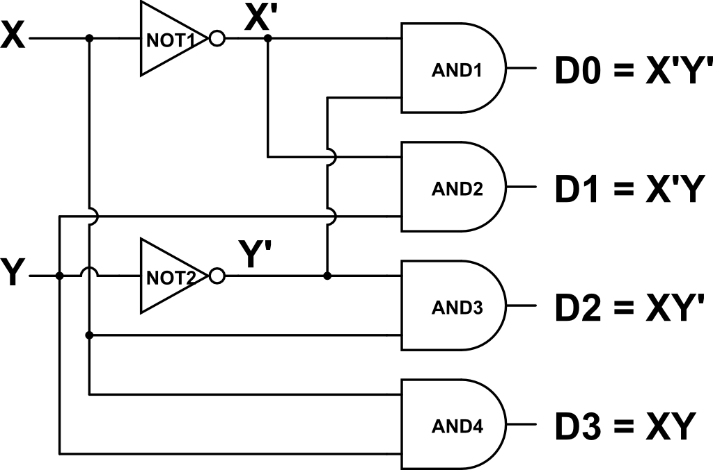
Example: active-high 2-to-4 decoder
Input is a 2-bit unsigned integer with bits XY, Output points to 2²=4 locations: D0, D1, D2, D3
Truth table and circuit; 2 inputs, 2² outputs, asserted output identified by logic 1 voltage
X | Y | D0 | D1 | D2 | D3
0 | 0 | 1 | 0 | 0 | 0
0 | 1 | 0 | 1 | 0 | 0
1 | 0 | 0 | 0 | 1 | 0
1 | 1 | 0 | 0 | 0 | 1

Slide 7
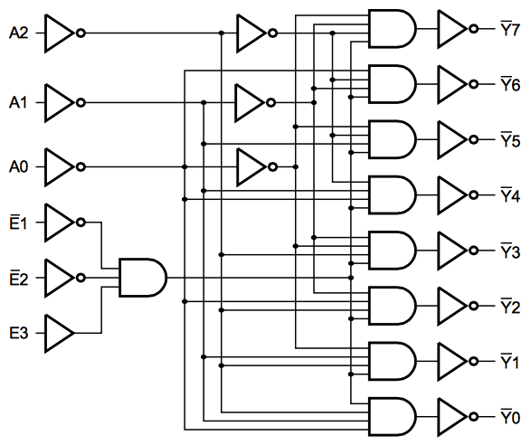
Active-low 3x8 decoder
2 gate delays
1 gate delay
3 gate delays
A2 | A1 | A0 | Y7’ | Y6’ | Y5’ | Y4’ | Y3’ | Y2’ | Y1’ | Y0’
0 | 0 | 0 | 1 | 1 | 1 | 1 | 1 | 1 | 1 | 0
0 | 0 | 1 | 1 | 1 | 1 | 1 | 1 | 1 | 0 | 1
0 | 1 | 0 | 1 | 1 | 1 | 1 | 1 | 0 | 1 | 1
0 | 1 | 1 | 1 | 1 | 1 | 1 | 0 | 1 | 1 | 1
1 | 0 | 0 | 1 | 1 | 1 | 0 | 1 | 1 | 1 | 1
1 | 0 | 1 | 1 | 1 | 0 | 1 | 1 | 1 | 1 | 1
1 | 1 | 0 | 1 | 0 | 1 | 1 | 1 | 1 | 1 | 1
1 | 1 | 1 | 0 | 1 | 1 | 1 | 1 | 1 | 1 | 1
0
A2
A1
A0
Three address bits A₂A₁A₀ name 2³ = 8 locations (8 rows)
Eight outputs, Y₇Y₆ … Y₁Y₀, each point to 1 distinct location
Notes:
Easy SOP circuit

Slide 8
Lecture 13 – Evening midterm exam
2018.02.06

Slide 9
Midterm 1 status (11:00am Feb. 09)
Scantron sheets
Scanned Wednesday afternoon
Multiple choice question scores uploaded
Gradescope
Scanning completed Wednesday afternoon
I have scored 5 of 11 questions
Plan to “return” midterm and discuss Monday

Slide 10
Lecture 14 – Instruction Set Architecture (ISA)
2018.02.09
It's about discipline.
It's about following instructions.
It's about the execution of the plan.
That's what sport is.
– Ian Millar, Olympic athlete

Slide 11
Week 06 assignments
Read chapters 5, 6, and 7
HW 04 due Thursday, Feb 15
Lab 05 due Week 06
Notes:
15 clickers recorded, but without associated student name

Slide 12
Instruction set architecture (ISA)
Instruction set architecture: the set of operations that a processor circuit performs and their representation
The set of operations to perform is a design choice
More operations may provide improved performance, better marketability
More operations increase gate count, circuit design and validation effort, chip area (and chip area is a good proxy for chip cost), heat production
Deciding on the instruction set involves making complex trade offs
Cf., creeping featurism, greedy algorithm, backwards compatibility
Instruction representation, or instruction format
Defines how the machine interprets bit strings as instructions
Defines the interface between software and hardware
Notes:
Cf. – abbreviation for the Latin confer/conferatur meaning compare

Slide 13
ISA trade off
A balance achieved between two desirable but incompatible features; a compromise
“You can’t have everything.
Where would you put it?”
– Steven Wright
comedian

Slide 14
Fetch-Execute and the machine
Each iteration of the Fetch-Execute cycle model causes the machine (the circuit) to fetch one instruction and execute it
A circuit corresponds to a truth table, therefore each machine instruction defines precisely
The computation that the instruction performs
The detailed functionality of the computational circuit, including any possible error conditions and responses
All signals necessary to select among choices for the operand(s) for the computational circuit and to select among destinations for the result(s)
The operand(s) [if any]
Their representational form, acceptable values, and the wires that their bit strings will use to reach the computational circuit
How to find the operand bit string(s) and place a copy of them on the wires
The result(s)
The representational form of the result(s); machine instructions with multiple results are common
Where to store the result(s)

Slide 15
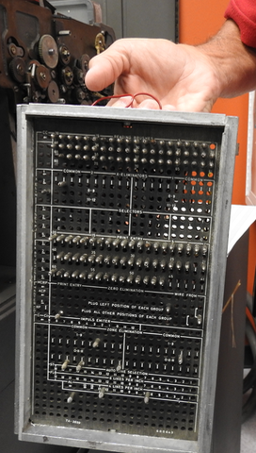
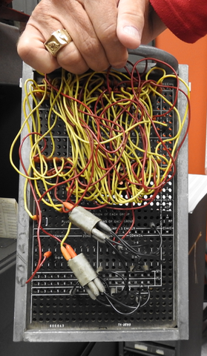
Hardware is fixed; how make choices?
Today hardware is not re-configured when we want to execute a different program
In the past it was, because hardware was so expensive
Plugboard holds wires to connect to any of a computer’s hardware devices. Like lab kit uses breadboard and wire to link any combination of devices in the kit.
Plugboard holding the wires of a specific program.

Slide 16
Choosing operands: the multiplexer
Multiplexer choses 1 of 2^{n} buses and sends bit string on that bus to the mux output bus
Allows all operand sources to be hardwired to the central computation circuits, yet specific operand(s) can be chosen electronically by pointing
0
1
2^{n}-1
… Input buses …
0
1
Mux
Address
…
n-1
Output bus

Slide 17
Saving results: the de-multiplexer
De-multiplexer sends bit string on 1 input bus to 1 of of 2^{n} demux output buses
Allows all result destinations to be hardwired to the central computation circuits outputs, yet specific result destination can be chosen by pointing
Input bus
0
1
De-mux
Address
…
n-1
… Output buses …
0
1
2^{n}-1

Slide 18
Storing (remembering) operands & results
Operands and results are always strings of bits
Bit strings can be stored in a collection of latches, called a register
Basic structure of execute circuit for 2-operand, 1-result instruction
Register
Mux
Register
Computatoin
Demux
Register
Mux
Register

Slide 19
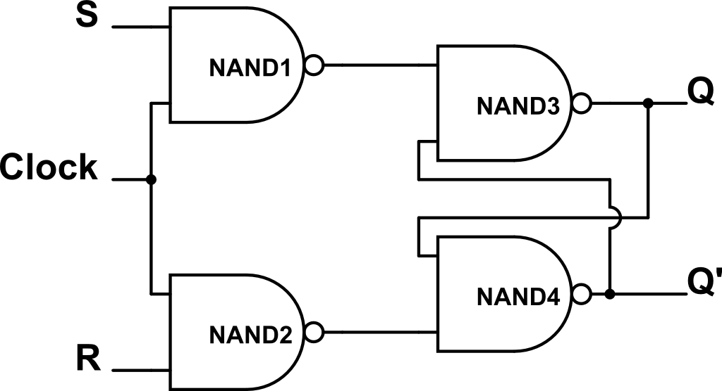
Improved register component: RS Flip-Flop
RS flip-flop is S’R’ latch controlled by a clock
If Clock=1, then S and R inverted and sent to latch
If Clock=0, then latch sees S’=1 and R’=1
Characteristic table
S | R | Q(t+1) | Comment
0 | 0 | Q(t) | No change
0 | 1 | 0 | Reset
1 | 0 | 1 | Set
1 | 1 | ? | Not allowed

Slide 20
Edge-triggered, n-bit register
A_{n-1}
A_{n-2}
A₂
A₁
S
R
A₀
Input
Edge-triggered Clock
1-bit
F-F
1-bit
F-F
1-bit
F-F
1-bit
F-F
1-bit
F-F
1-bit
latch
Q_{n-1}
Q_{n-2}
Q₂
Q₁
Q₀
Output
V-shape on clock input means edge-triggered Falling clock edge is when newly-stored A bit appears on Q output

Slide 21
Nature of a machine instruction
A machine instruction specifies
Opcode – the operation to perform
Operand(s) [if any] – by value or by location if location is not fixed
Location for result, if any

Slide 22
Early computers
Hardware was strongly quantity limited because
Cost per gate was high
Reliability of gates was low
Circuits with more than, say, a few thousand gates would likely contain a faulty gate
Computers were unfamiliar, hence used by a small community
Thus
Circuitry to execute instructions and to store useful amounts of instructions and data kept to a minimum
Users could be trusted with the whole system and were willing to deal with its lack of built in support for many things

Slide 23
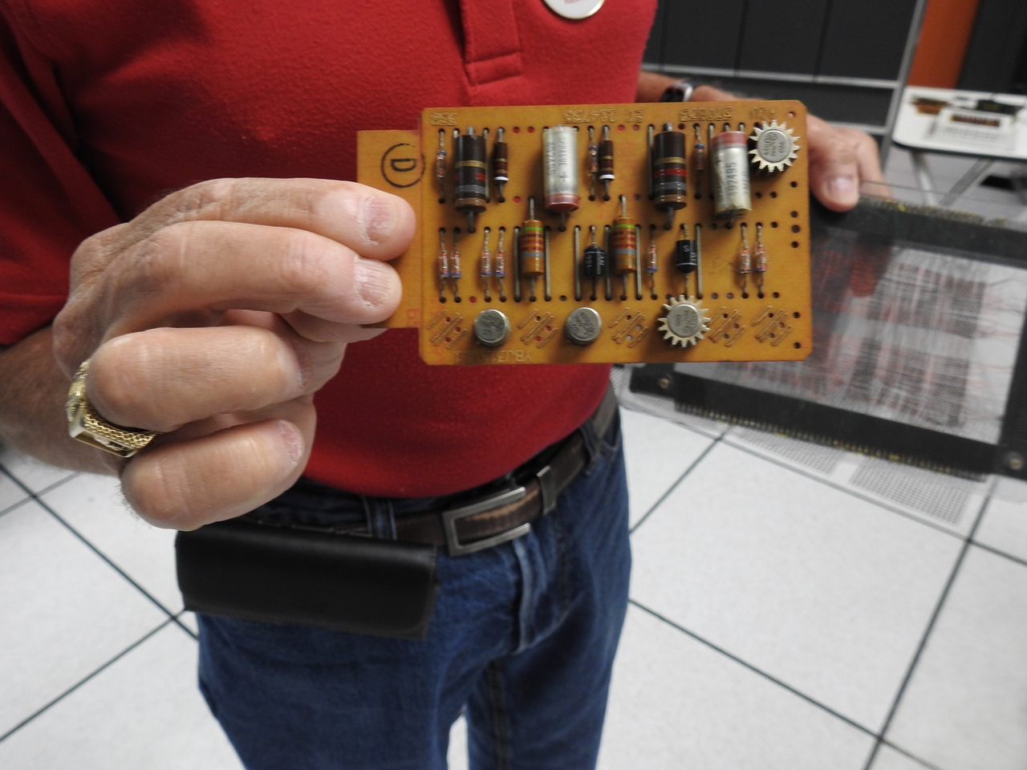
Example: IBM 1401 circuit card

